Slide 1
SQL For Data Cleaning

Slide 2
Why do we need to learn this ?
Data is not structured as we like.
Cleaning & organizing messy data
Changing Data types
Manipulating Nulls.
For text fields, we prefer having clean groups so that we can aggregate on them.

Slide 3

Prospective Customers Example – Usage of Left & Right
For example, extracting area code.
If the phone number format is same for all the numbers than we can use this function.
In this particular example, we can use LEFT command.
We can also use right if we are looking to extract characters from the right side.

Slide 4
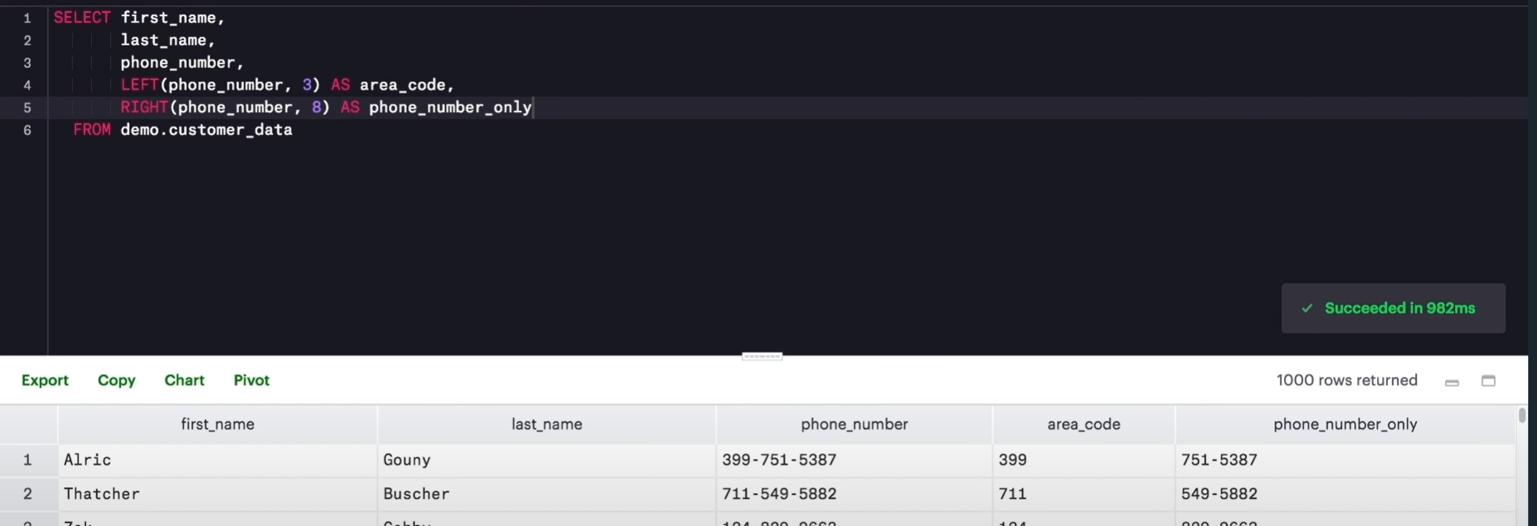
Left & Right Example

Slide 5
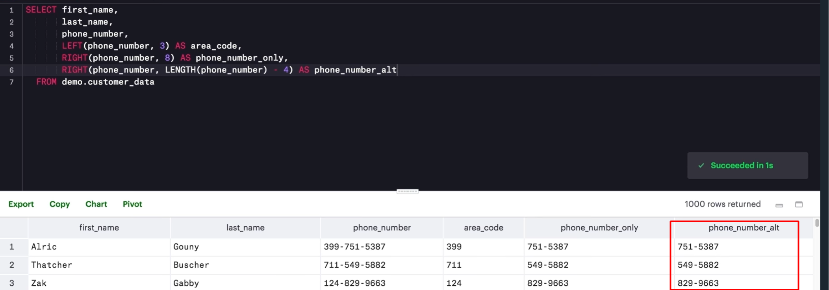
Making The string pulling dynamic
If we are unsure a little about the format.
We can use LENGTH in certain cases.
Use the function length inside right & left function

Slide 6
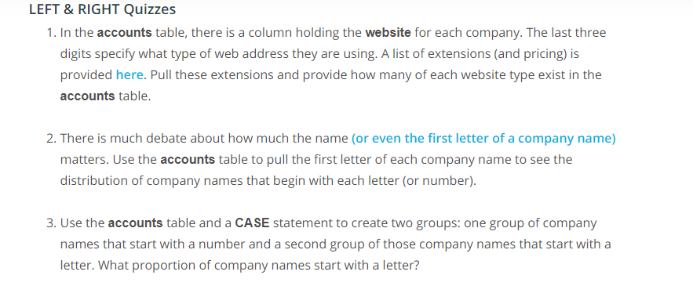
Quiz Left & Right

Slide 7
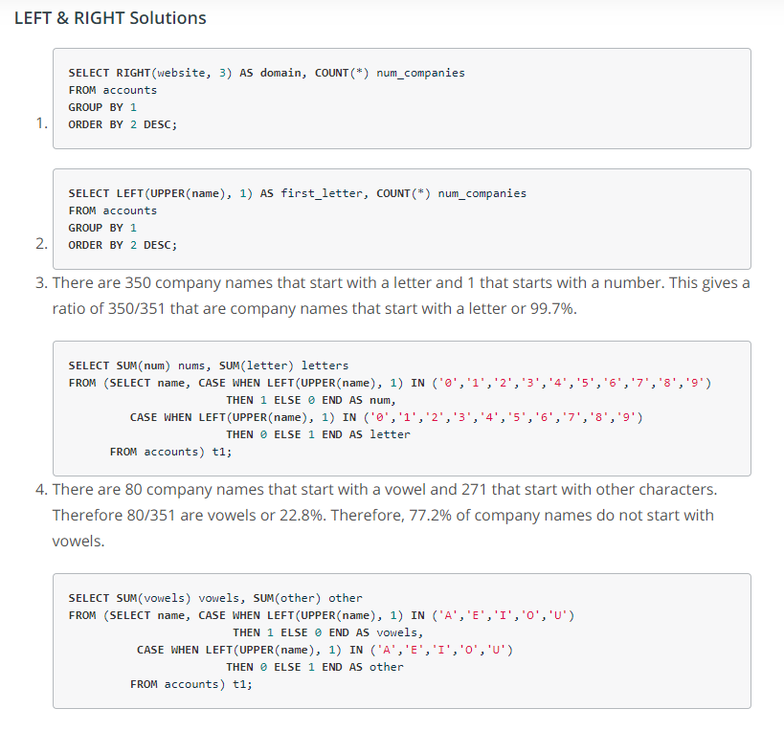
Quiz Solution

Slide 8
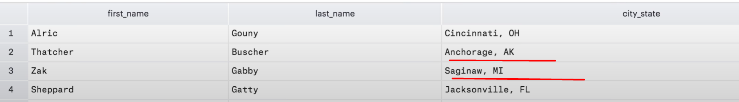
Why cant Left & Right Suffice ?
Left & Right works very well when the data is structured cleanly with certain number of characters.
For example, here if we would like to separate City & State we need to do more work since both are of variable length.

Slide 9
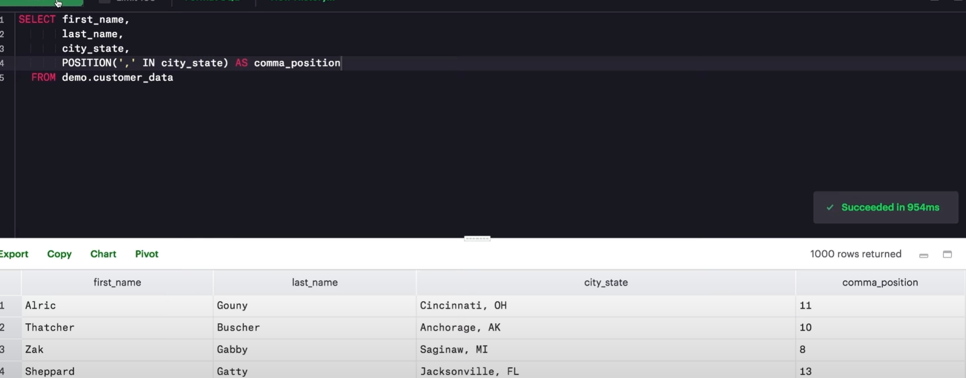
Position
We need to figure out where City & State are Splitting. We cannot use length here.
We need to find the comma here.
POSITION allows us to find the position of a particular character in a column.

Slide 10
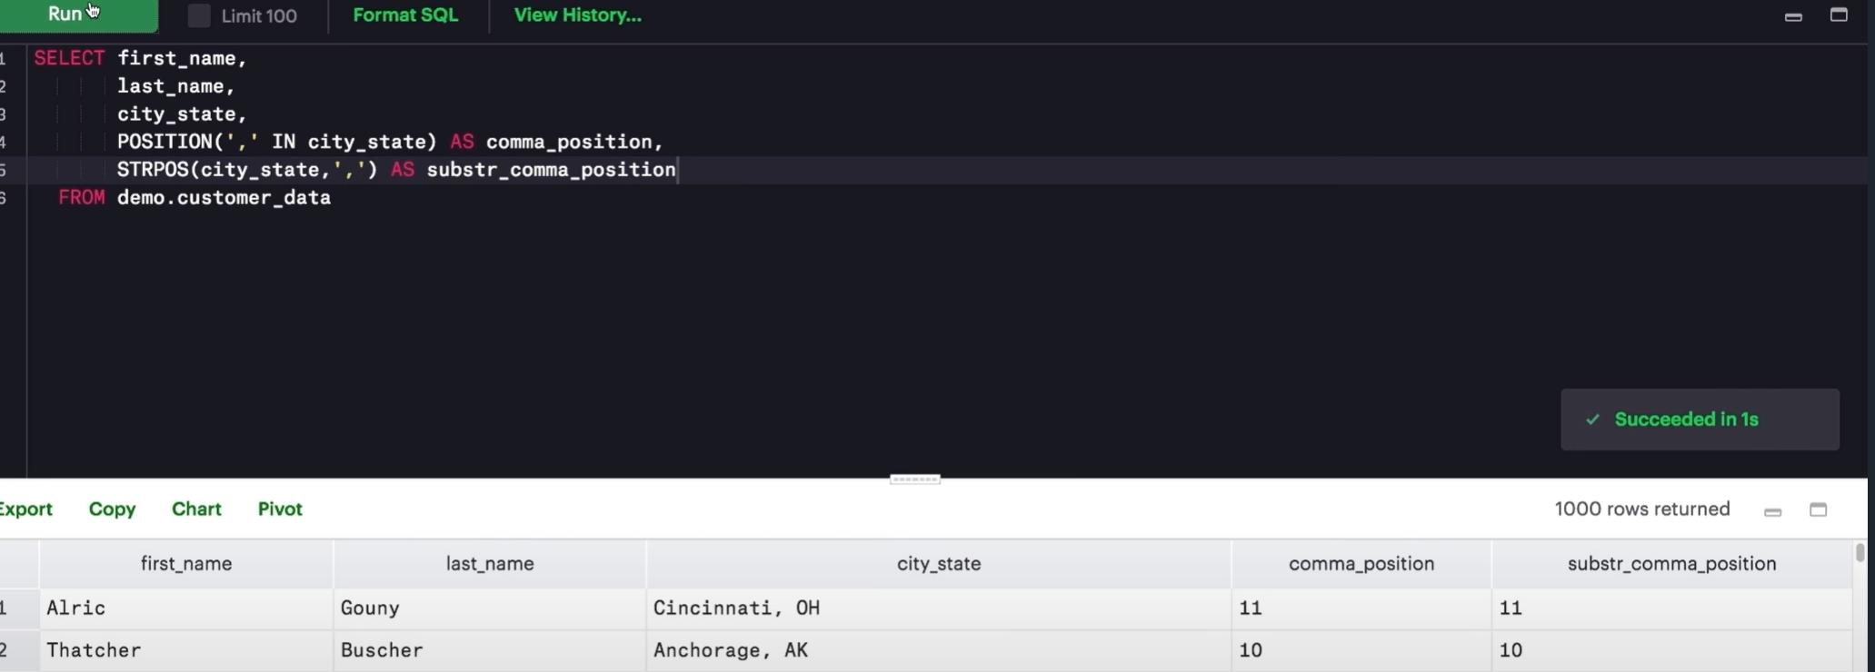
STRPOS
STRPOS function returns the position of a string counting from the left.
It can also give us the same results as Position argument.

Slide 11
POS & STRPOS
Both are case sensitive
Use UPPER & lower to force the case.

Slide 12
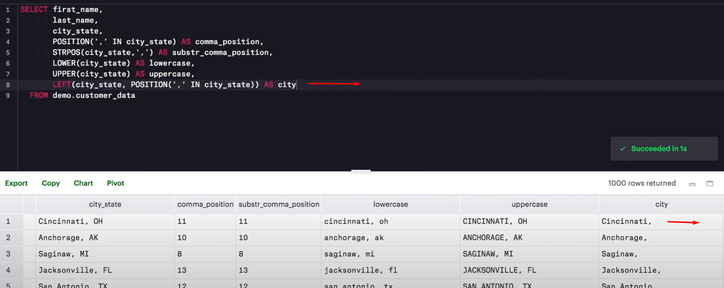
Making Extraction dynamic with using Position
If we can get the position in every record, than we can easily extract the required portion dynamically.
Using position as a nested function within left or right function as needed.
Notes:
If we don’t need comma, we can limit our extraction by subtracting one from the result of the position function.

Slide 13
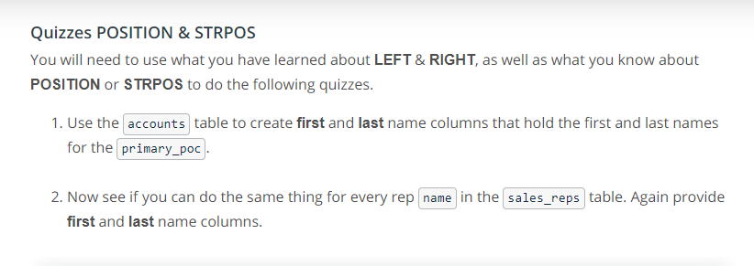
Quiz Position, STRPOS

Slide 14
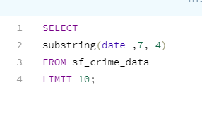
Substring Example
Parameters are the column or string
Index from which we want to extract it
Than number of characters till which we want

Slide 15
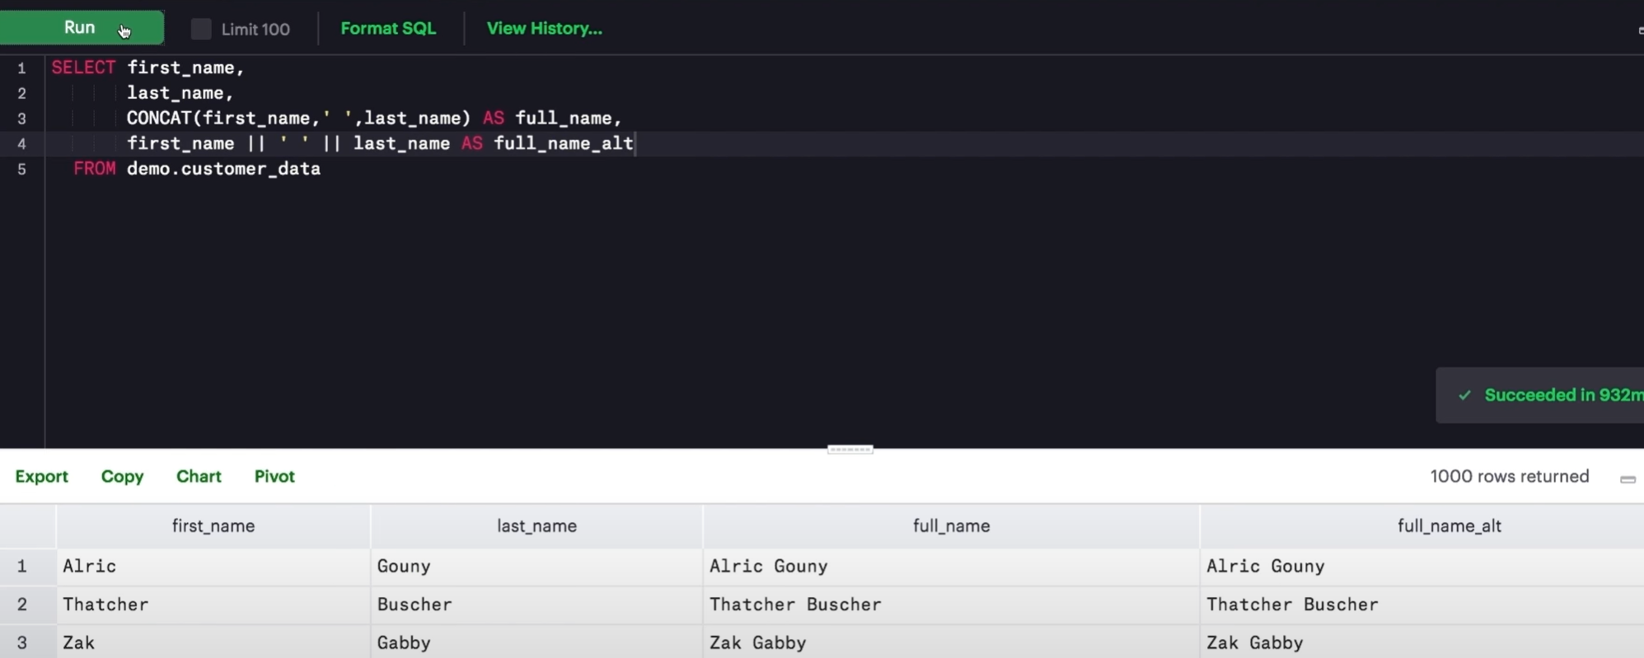
CONCAT
Required for combining data from multiple columns
We can use CONCAT
We can also use 2 pipe characters for the same concatenation

Slide 16
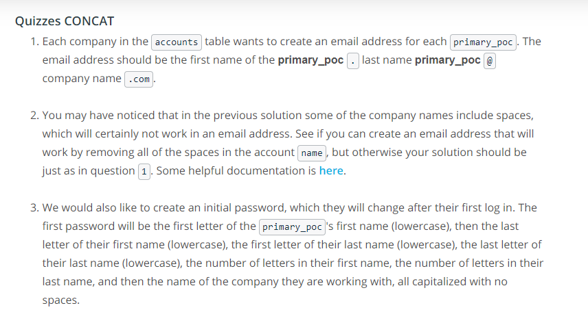
Quiz CONCAT

Slide 17
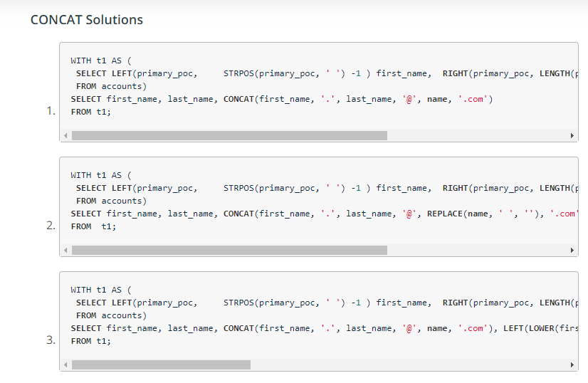
Quiz Solution

Slide 18
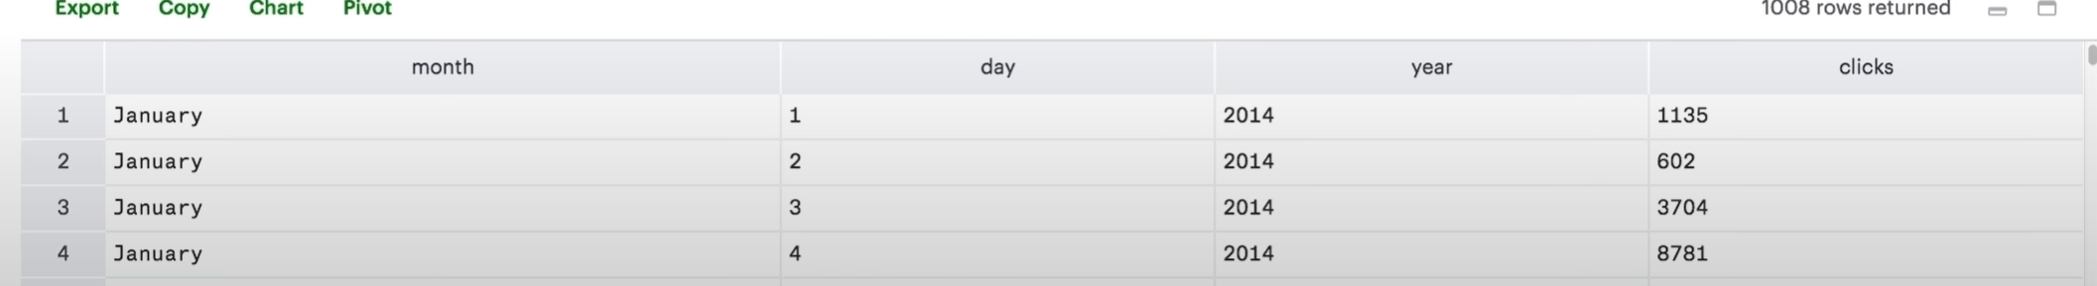
CAST
Dates are very important in real life analysis.
However, dates are mostly not correctly formatted.
For example, we may have months, day, years in separate column, problems like these occur when data has been manipulated, combined from different sources & tools.
For this, we need to convert months into numbers then we need to concatenate fields using hyphens.
We also need to tell database the result is a date. For this purpose, we use CAST.

Slide 19
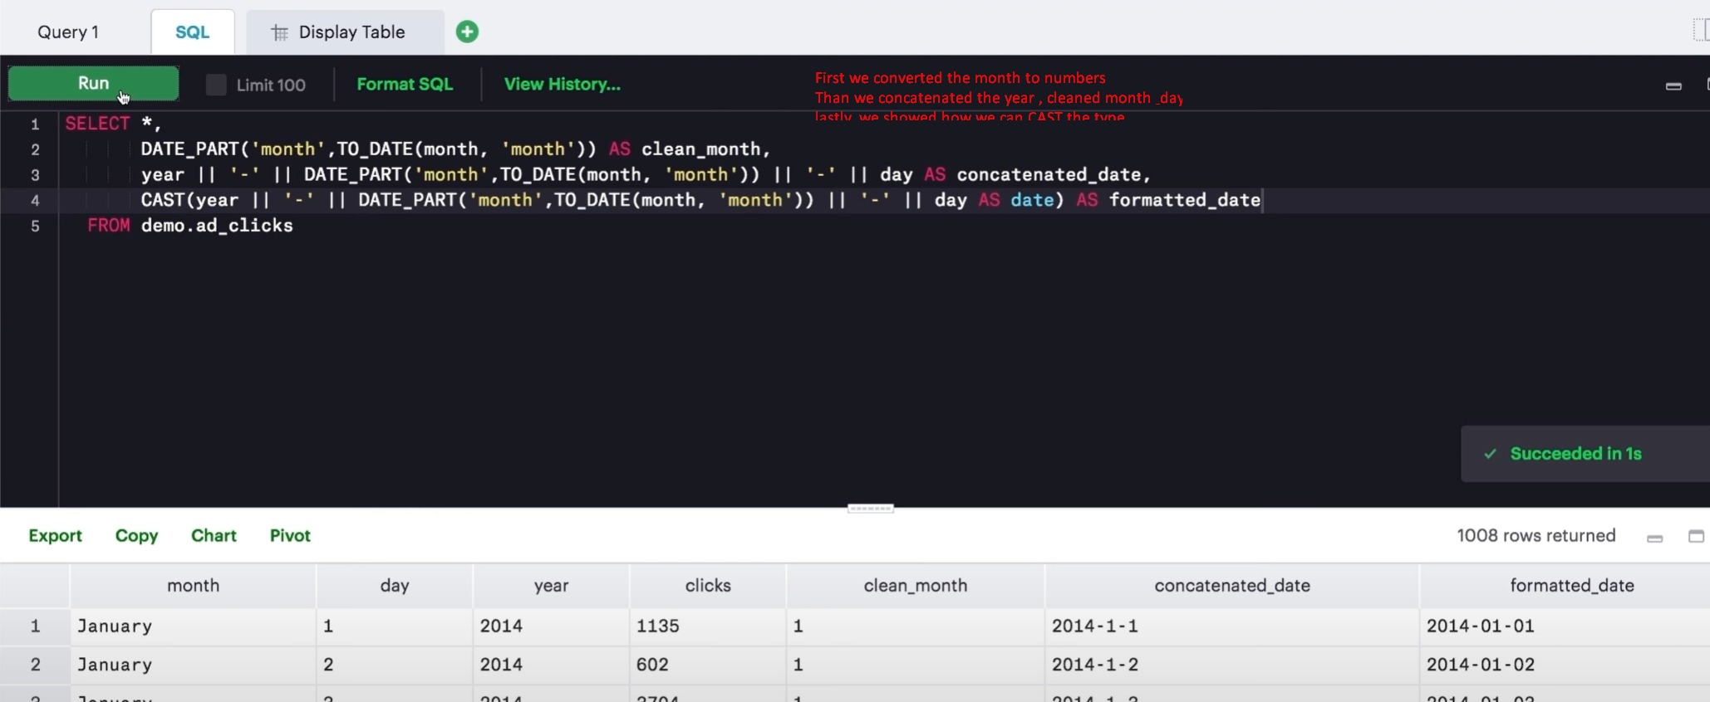
CAST Example
Cast lets us change the data type of the columns.

Slide 20
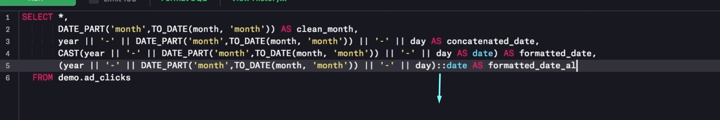
Alternative Syntax
Rather than using CAST, we can also do this.
Add :: at the end of the column followed by the type to which we want to cast the column.

Slide 21
Usage of CAST Function
Mostly used to convert strings to numbers or dates.
Typically the string operations like left, right & substring automatically cast the data type.

Slide 22
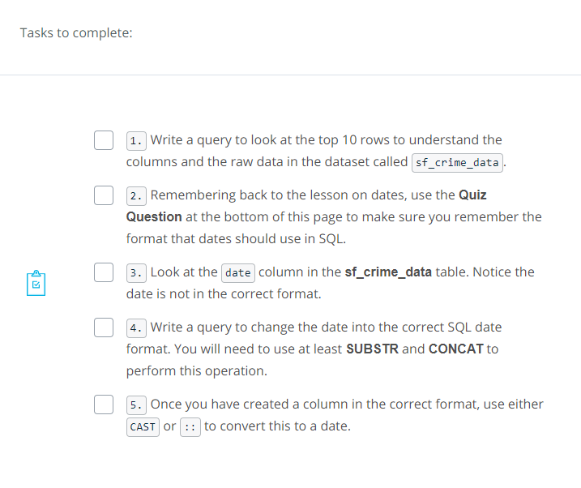
Quiz CAST

Slide 23
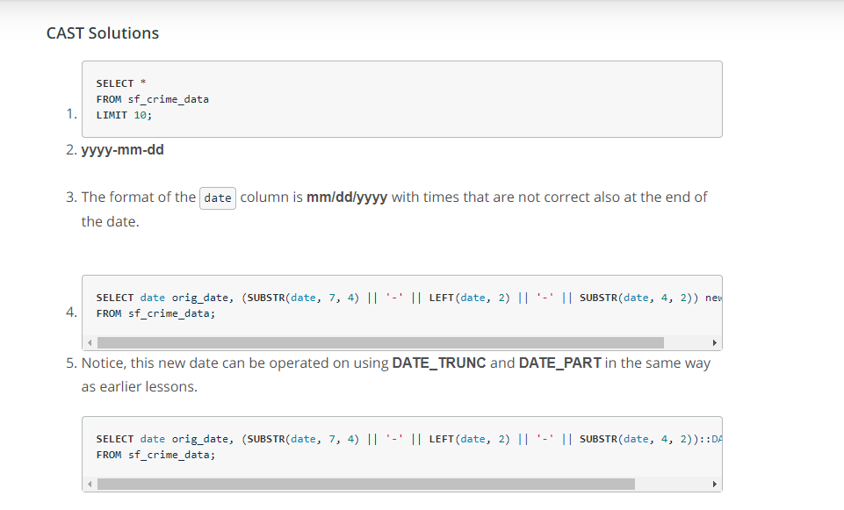
CAST Quiz Solution

Slide 24
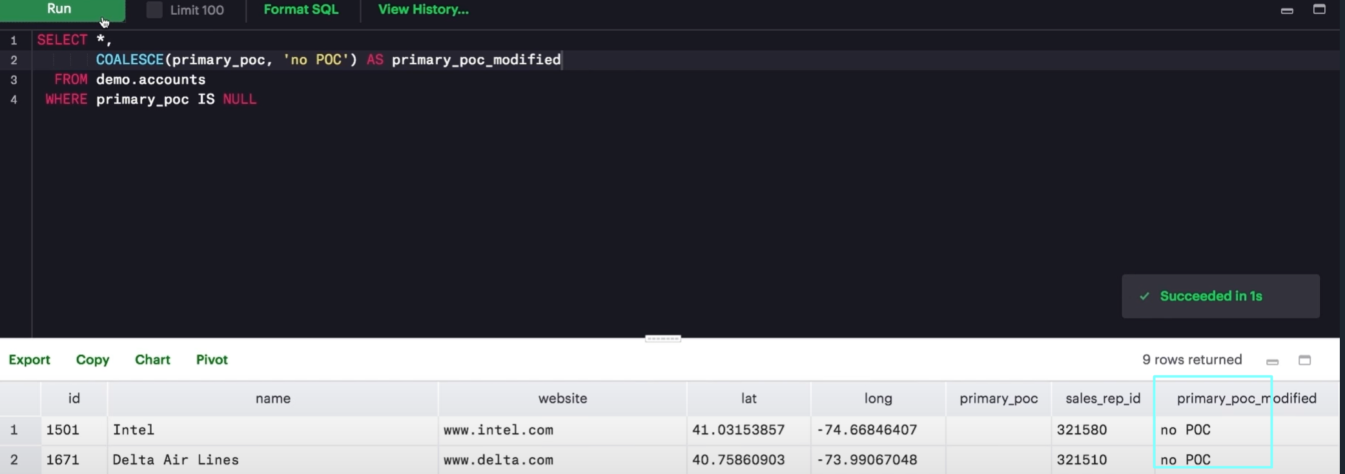
COALESCE
Sometimes data has null & we prefer for them to have some values.
For example, if a Primay contact is null we would like to label it with something like No POC.
That’s where we use COALESCE

Slide 25
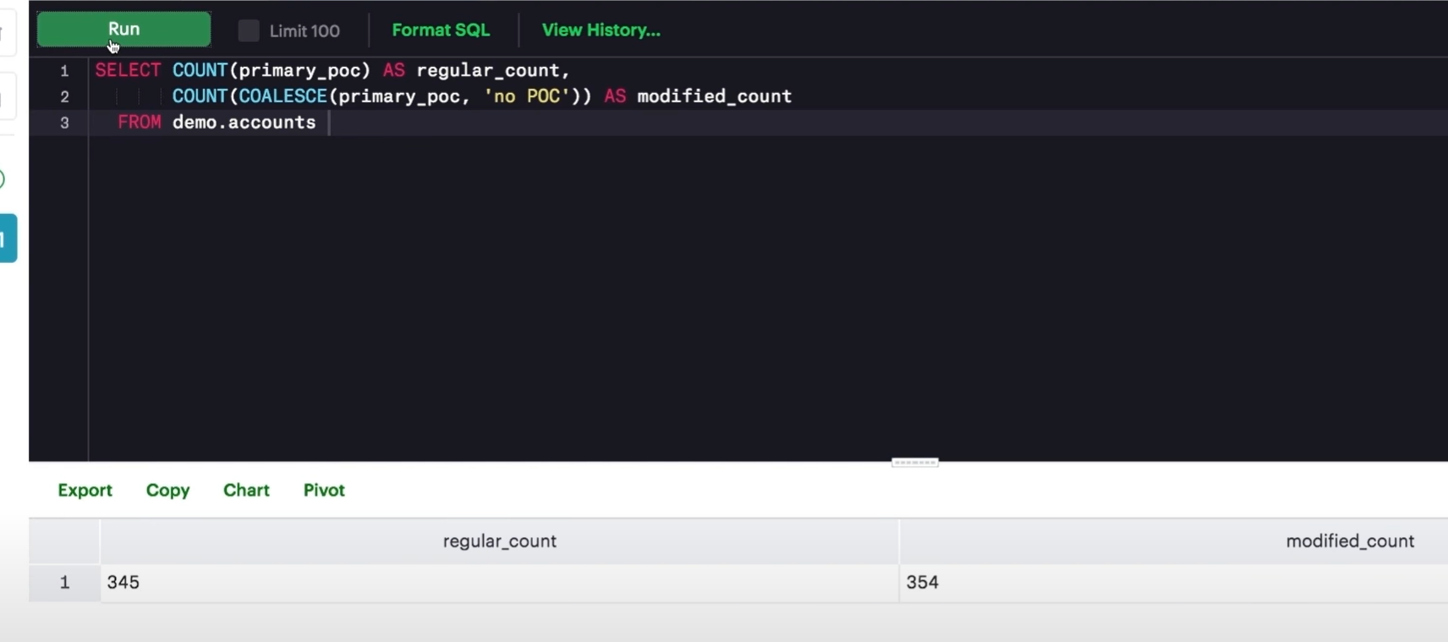
COALSECE & Numerical Columns
In numerical columns we would often like to replace or display nulls with 0s.
This may help in case of count operators since it considers nulls & does not include null rows.

Slide 26
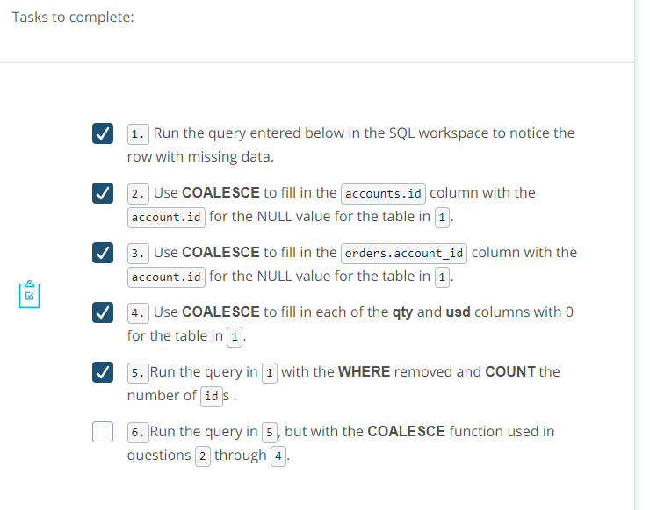
COALESCE Quizzes

Slide 27
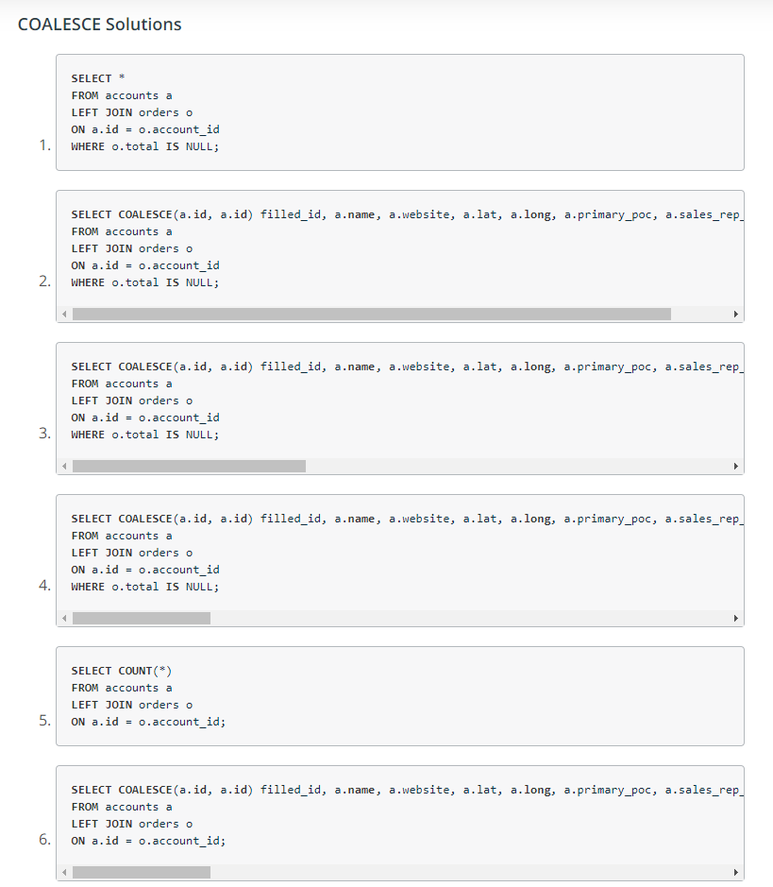
Quiz Solution

Slide 28
Summary & More Resources
Cleaning data is easy in SQL.
Necessary in analysis.
https://www.w3schools.com/sql/sql_isnull.asp
https://mode.com/sql-tutorial/sql-string-functions-for-cleaning/

